Slide 1
HowTo: Bare Metal OpenShift Windows and Linux
Glenn West, Principle Engineer
How-To – July 5, 2018

Slide 2
Overview
Nodes Needed
Windows Requirements and Preparation
OVN Setup
Windows Setup

Slide 3
Where To Find It
OVN and Windows Setup
https://github.com/glennswest/hybrid

Slide 4
Usage – 2 ways to use
Use the hybrid-openshift-contrib
Provides the auto creation of a complete cluster and all the related infrasturure.
3 Masters, 3 Infra, 1 or more compute nodes, and 1 or more windows nodes
Requires OpenShift Subscriptions/Rhel and/or Employee Subscription
Requires a Azure Subscription
Hybrid Scripts (Covered in this doc)
Self provision bare metal or Any cloud provider, provide a ansible host file, and use the ansible OVN and Windows scripts. Assume you have a bastion host.

Slide 5
Hosts Needed
All machines running RHEL 7.4 or later
A Bastion Host (Small machine / VM – Min 2 cores and 8G Memory
Qty 1 Infra Nodes (Small Machine / VM – Min 4 cores and 12G)
Qty 1 Master Nodes (Small Machine / VM – Min 4 cores and 12G)
Qty 1 or more Compute Nodes (Min 4 cores and 12G)
Qty 1 Windows Nodes (Min 4 cores and 12 Gig)

Slide 6
Subscriptions
Scripts are tested with 3.9 GA Openshift – Subscription Required
RHEL Subscription is Required
Windows License is required, and must be able to update image

Slide 7
Windows Version
Windows Datacenter Core 1709 with Containers
Disk size must be 120Gig or Greater (Must expand partition to full size)
Must be updated to latest patches.
Initial Node Setup is required.

Slide 8
Windows Nodes Preparation – Ansible Setup
Login to Each node via RDP or Console
Do the following commands as Administrator
powershell
[Net.ServicePointManager]::SecurityProtocol = [Net.SecurityProtocolType]::Tls12
Invoke-WebRequest -Uri https://raw.githubusercontent.com/glennswest/hybrid/master/bin/winansible.ps1 -OutFile "winansible.ps1" -UseDefaultCredentials

Slide 9
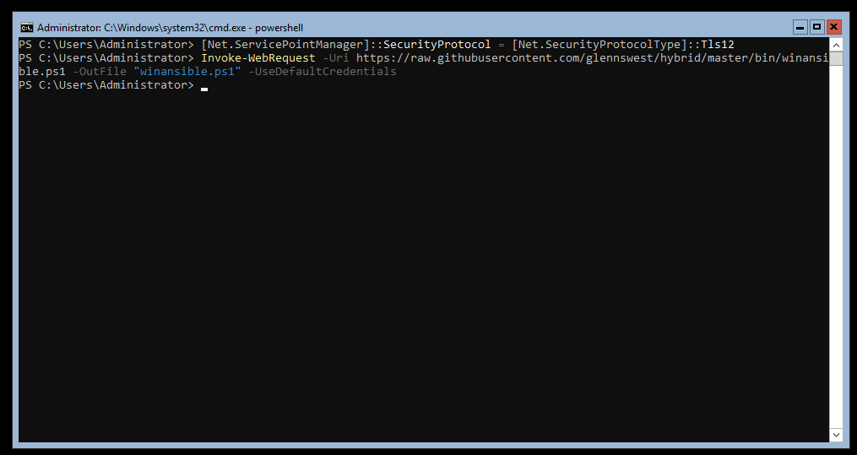
Example:

Slide 10
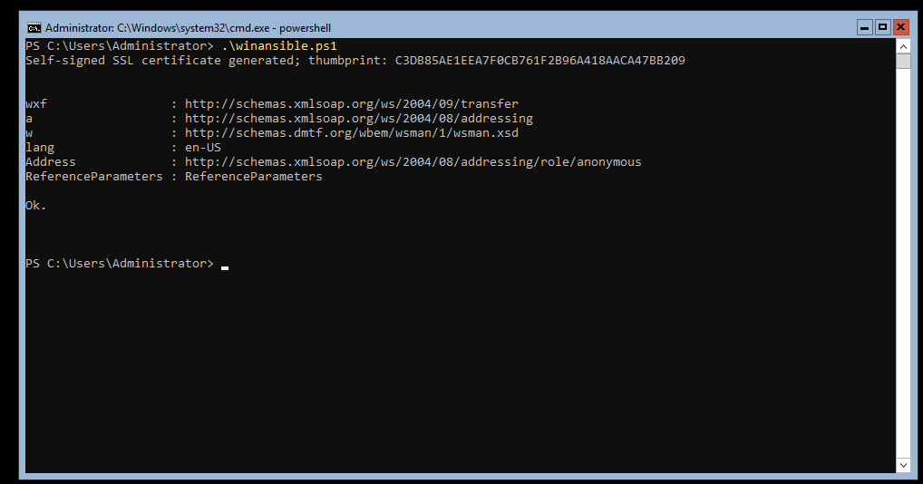
Run the winansible script
To enable ansible to manage the windows node:

Slide 11
Next Step: On bastion host
Login to the bastion host
As Root:
yum –y install git
git clone https://github.com/glennswest/hybrid
yum install –y ansible
cd hybrid

Slide 12
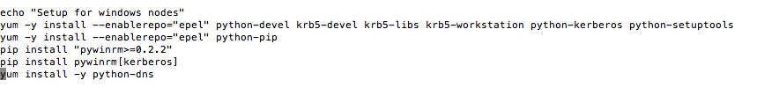
Prepare on bastion to use ansible for Windows
Uses Ansible on Windows
Must have a windows group in ansible inventory
There is a example ansible file
If using script separately, must do some setup before:

Slide 13
Install OpenShift
Connect to your bastion host
Use the OpenShift Advanced Installer and do a new install
Important variables in the host file:
oreg_url=registry.access.redhat.com/openshift3/ose-${component}:${version}
openshift_use_openshift_sdn=false
os_sdn_network_plugin_name=cni
deployment_type=openshift-enterprise
Example:
https://github.com/glennswest/hybrid/blob/master/examples/ansible.hosts.multi

Slide 14
Openshift Required Host Names
Masters
master1
master2
Master3
Infranodes
Infranode1
Infranode2
Infranode3
Compute
node01
Windows
winnode01
winnode02

Slide 15
Next Step (After OpenShift Install)
Run:
As root: ansible-playbook ovn_presetup.yml
As root: ansible-playbook ovn_postsetup.yml
As root: windows.yml

Slide 16
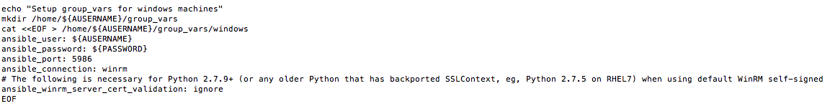
Setting up Windows group_vars
Must create a group_vars to setup windows nodes
The following is done automatically in bastion.sh in the ARM template

Slide 17
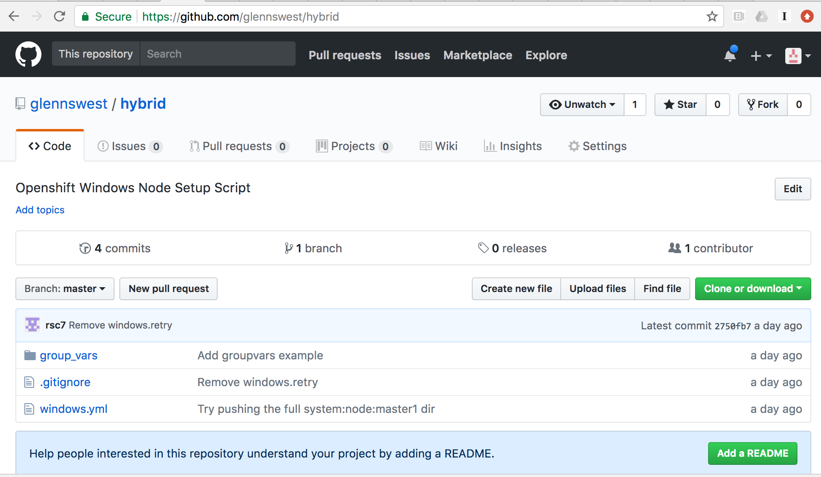
Hybrid Script – Windows Node Setup

Slide 18
Current Issues
Need to check the ovn_kubernets_node on each linux node, and restart if having access issues
For windows containers, deploy_configs do not work, must use deployment
Docker Builds do not work within openshift, must build and push containers online
Windows Containers must be marked as privileged.

Slide 19
Updates – June 29, 2018
All windows scripts have been merged togeather.
Windows docker setup, disk expansion, and ovn network setup are all done headless and automatically as part of the windows.yml

